Slide 1
Delay Times as Quantum Resource primitives
Eric Chitambar
University of Illinois at Urbana-Champaign
Quantum Resource Theories Workshop
December 5, 2022
Joint work with:
Gilad Gour
Francesco Buscemi
Wenbin Zhou
Kaiyuan Ji
Yujie Zhang
Phys Rev. Lett. 124, 120401 (2020)
Phys Rev. A 104, 052208 (2021)
arXiv:2112.03717
arXiv:2211.xxxx

Slide 2
Outline of talk:
General Framework of Quantum Devices and Delay Times
A Resource Theory of Entanglement with Delay Times
A Resource Theory of Quantum Memory with Delay Times

Slide 3
General Framework of Quantum Devices and Delay Times

Slide 4
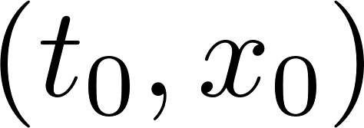
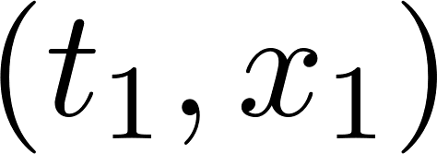
Quantum Devices and Input-to-Output Delay Time
Quantum Device

Slide 5
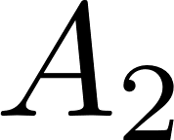
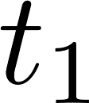
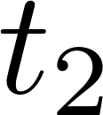
Input-to-Output Delay Time

Slide 6
Input-to-Output Delay Time for Multiple Systems

Slide 7
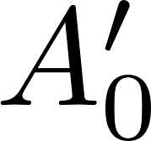
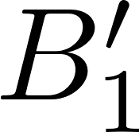
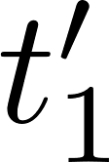
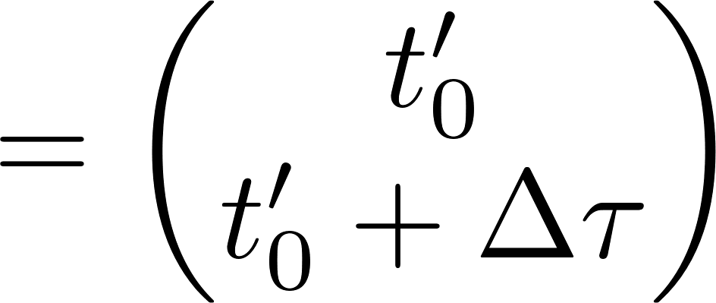
Input-to-Output Delay Times for Compound Devices

Slide 8
Input-to-Output Delay Times for Compound Devices
Eggeling et al. EPL 57 (2002)

Slide 9
Input-to-Output Delay Time for Compound Devices

Slide 10
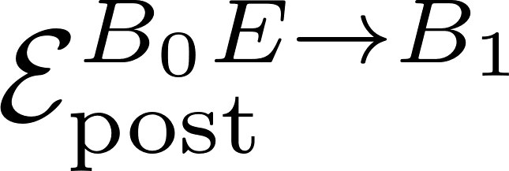
Quantum Combs as Compound Devices
Chiribella et al. EPL 101 (2008)

Slide 11
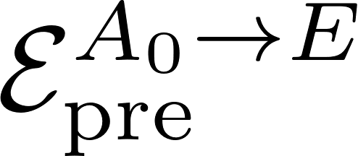
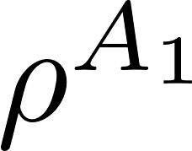
Quantum Combs as Compound Devices
Chiribella et al. EPL 101 (2008)

Slide 12
The Resource Theory of Entanglement with Delay Times

Slide 13
LOCC Devices
LOCC

Slide 14
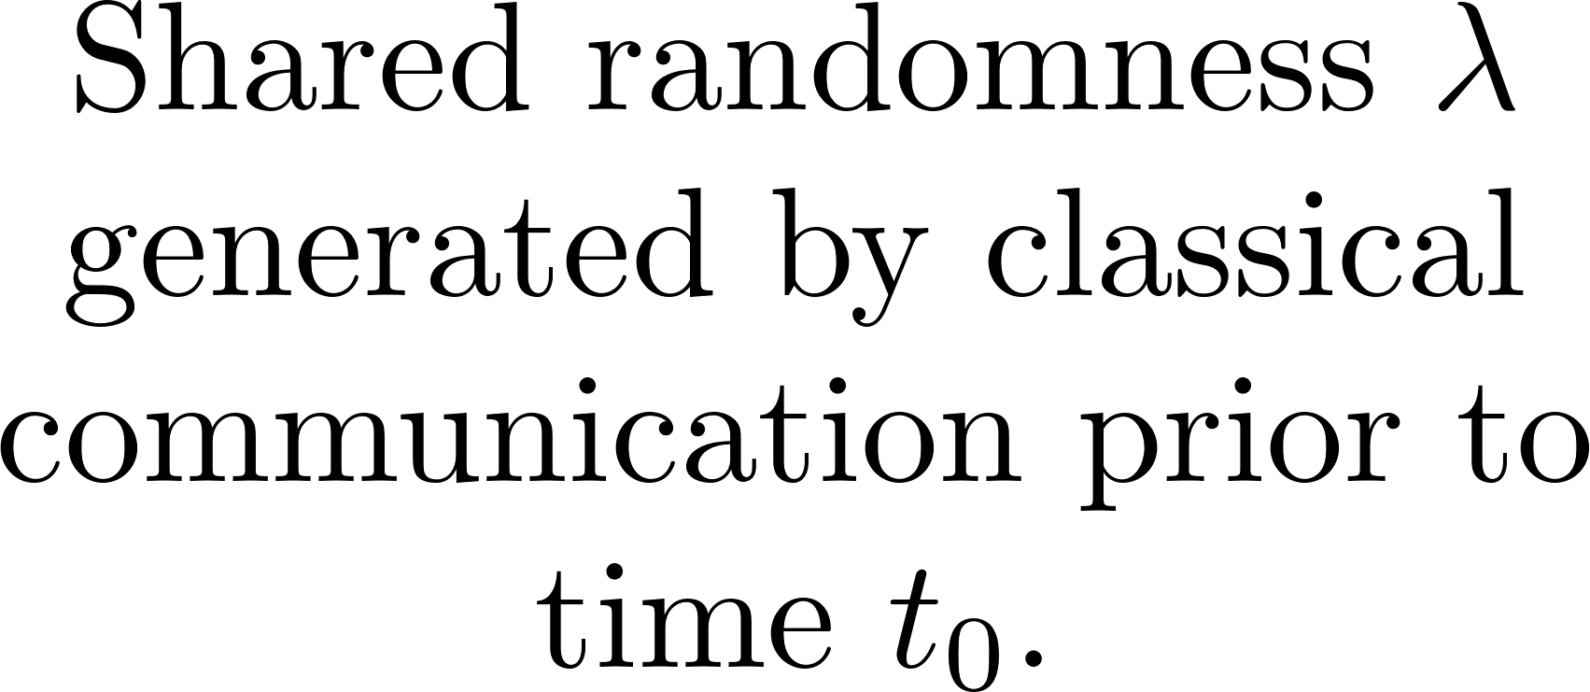
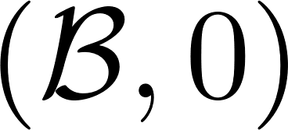
Instantaneous Multiparty Devices

Slide 15
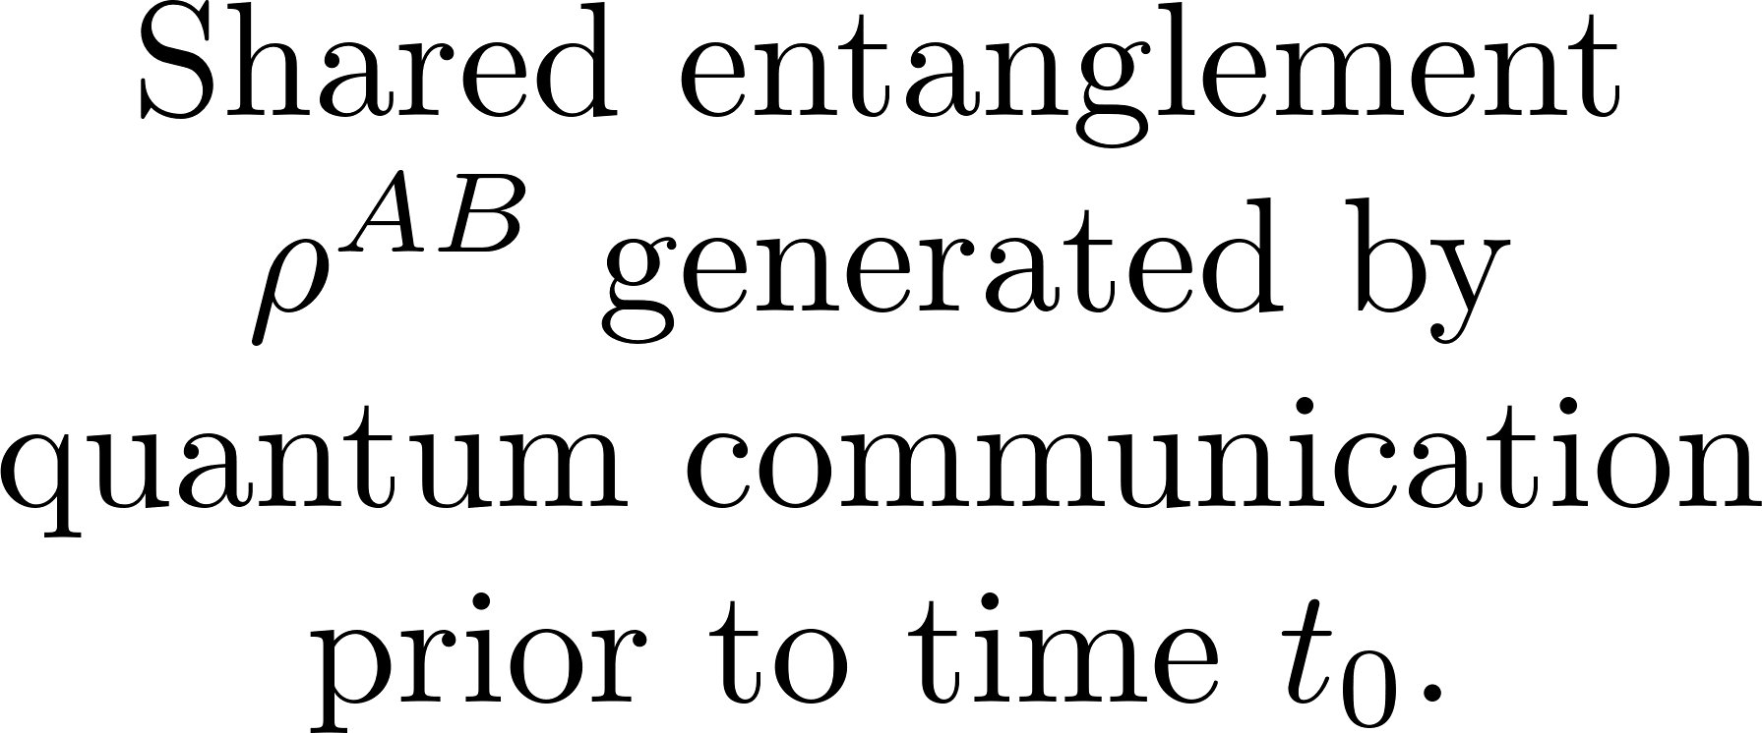
Instantaneous Multiparty Devices
Beckman et al. PRA 64 (2001)
Gutoski QIC 9 739 (2009)

Slide 16
LOSR and LOSE Devices

Slide 17
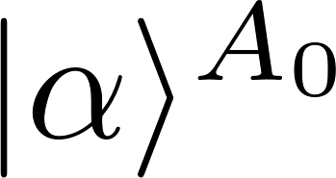
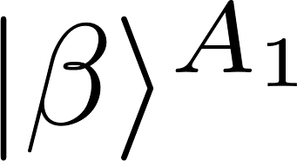
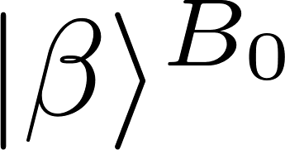
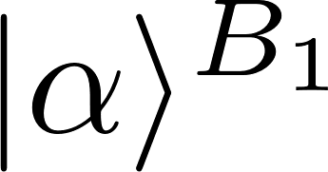
Instantaneous Multiparty Devices
SWAP
PR-Box
PR box ($∆τ>0)$
PR box or quantum swap ($∆τ=0)$
Quantum swap ($∆τ>0)$

Slide 18
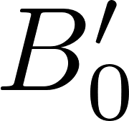
LOCC Processing of Devices
Alice’s side-channel
LOCC pre-processing
LOCC post-processing
Bob’s side-channel

Slide 19
Defining Entanglement with Delay Times
Alice’s side-channel
LOCC pre-processing
LOCC post-processing
Bob’s side-channel
LOCC

Slide 20
Defining Bell Nonlocality with Delay Times
Instantaneous LOCC processing (i.e. LOSR)
LOCC pre-processing

Slide 21
Defining Bell Nonlocality with Delay Times
Instantaneous LOCC processing (i.e. LOSR)
* Although arguably not in studies of causality
See Zjawin’s talk;
LOCC pre-processing

Slide 22
The Resource Theory of Incompatibility with Delay Times

Slide 23
Multi-Instrument Devices
Classical-Quantum Device

Slide 24
Multi-Instrument Devices

Slide 25
Multi-Instrument Devices

Slide 26
Programmable Instrument Devices
Quantum Internet
cq Device

Slide 27
Programmable Instrument Devices (PIDs)
Piani JOSA B 32 (2015)
Pusey JOSA B 32 (2015)
Wiseman et al. PRL 98 (2007)

Slide 28
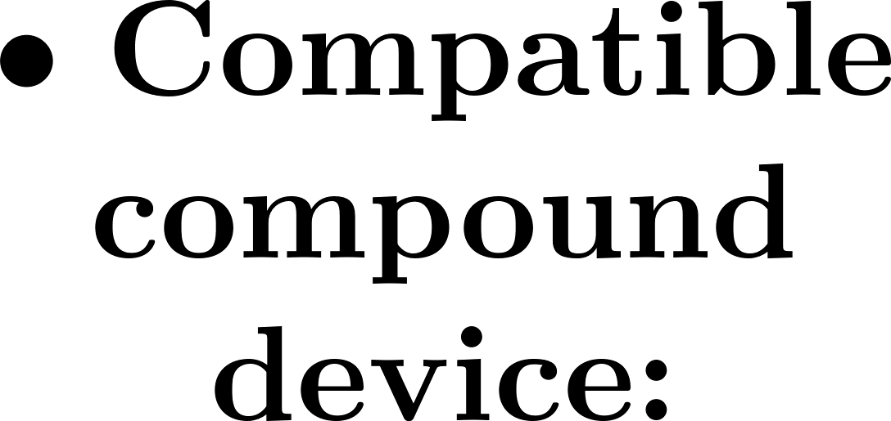
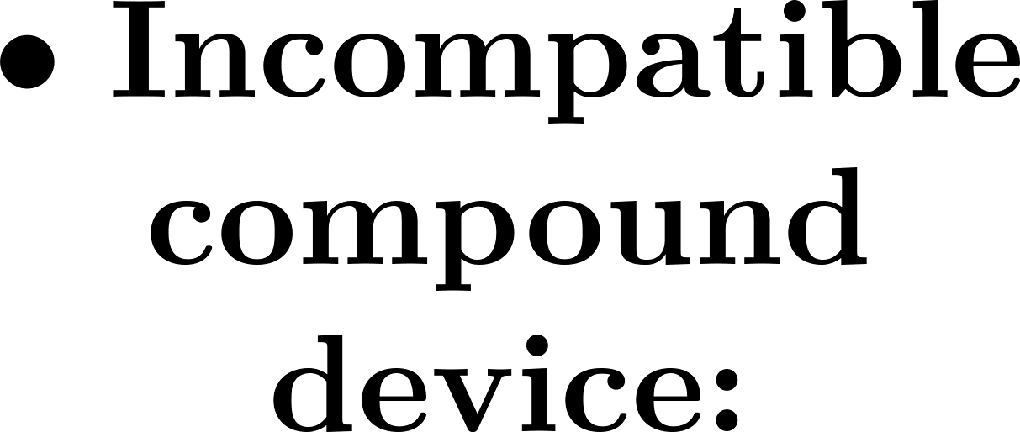
Incompatible Channel Assemblages
“Classical Compatibility”
See Buscemi’s talk;
arXiv:2211.09226
Classical memory
Quantum memory

Slide 29
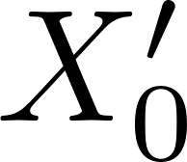
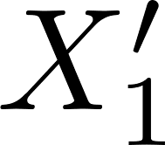
Processing PIDs
Chiribella et al. PRA 80 (2009)

Slide 30
A Resource Theory of Quantum Memory

Slide 31
A Resource Theory of Quantum Memory

Slide 32
A Resource Theory of Quantum Memory
arXiv:2112.03717
arXiv:2212.xxxx
Heinosaari et al. JPA 48 (2015)

Slide 33
Conclusions

